Slide 1


Mapping a new life in Christ according to a
Biblical True^North

Slide 2

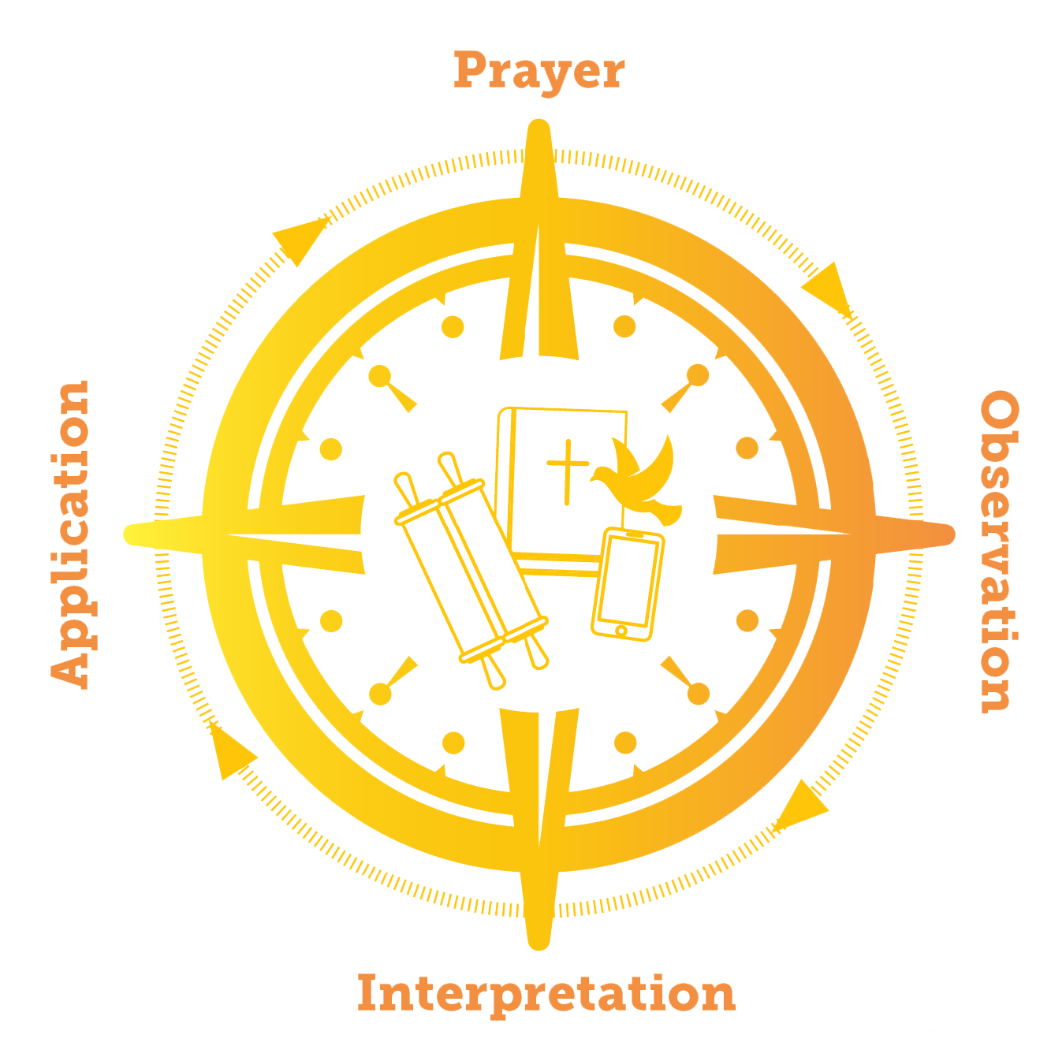
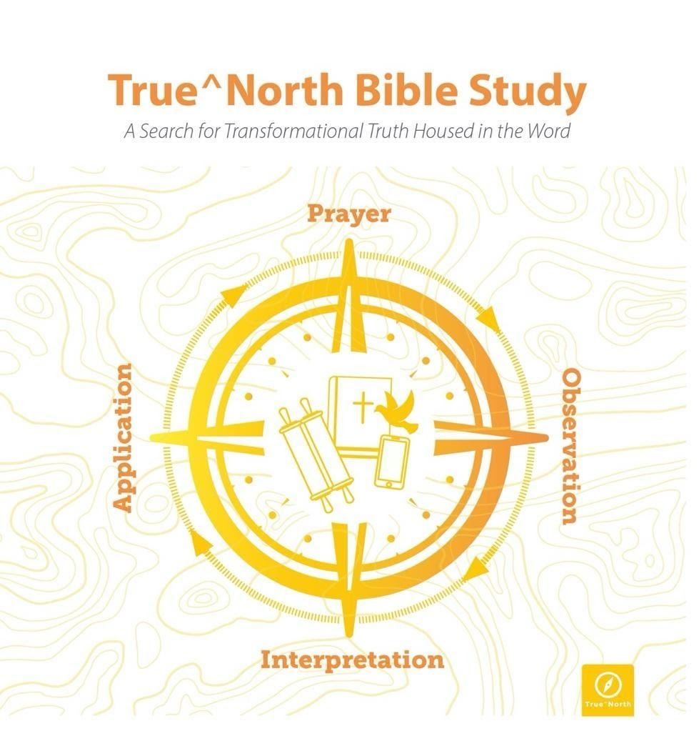
True^North
Disciple-Making in the Word
Disciple-making in the Word
The “WHY” of
Disciple-making in the Word
The “HOW” of
Disciple-making in the Word

Slide 3
87% of Churchgoers say, “What we need most from our church is to help understand the Bible in depth.”
Institute for Biblical Reading https://instituteforbiblereading.org

Slide 4
My Apology:
I taught my students
“How to read Scripture” rather than
“How to teach them how to teach others to read the Scriptures”
Notes:
You may be the very best “readier-Interpreter” of Scripture in the church
Not a bad thing at all for a Pastor…but it may not be the best things for the building up of the Body of Christ.
For is you are the only person with the skills to read-interpret-apply the biblical text…and if the Great Commission is to teach them to obey all things…seems to me that folks are only learning this on Sunday Morning. And since the most dedicated believers only attend church 2-3 times a month; they may be hearing from the Lord only a few hours a week.
And the average household in the US watches TV for 5.1 hours/day.
My friends, they are being discipled by someone or something. Just not by you, nor in the Word. Its Hollywood, NetFlix, and YouTube.

Slide 5
Two Approaches to the
Reading of the Word

Slide 6
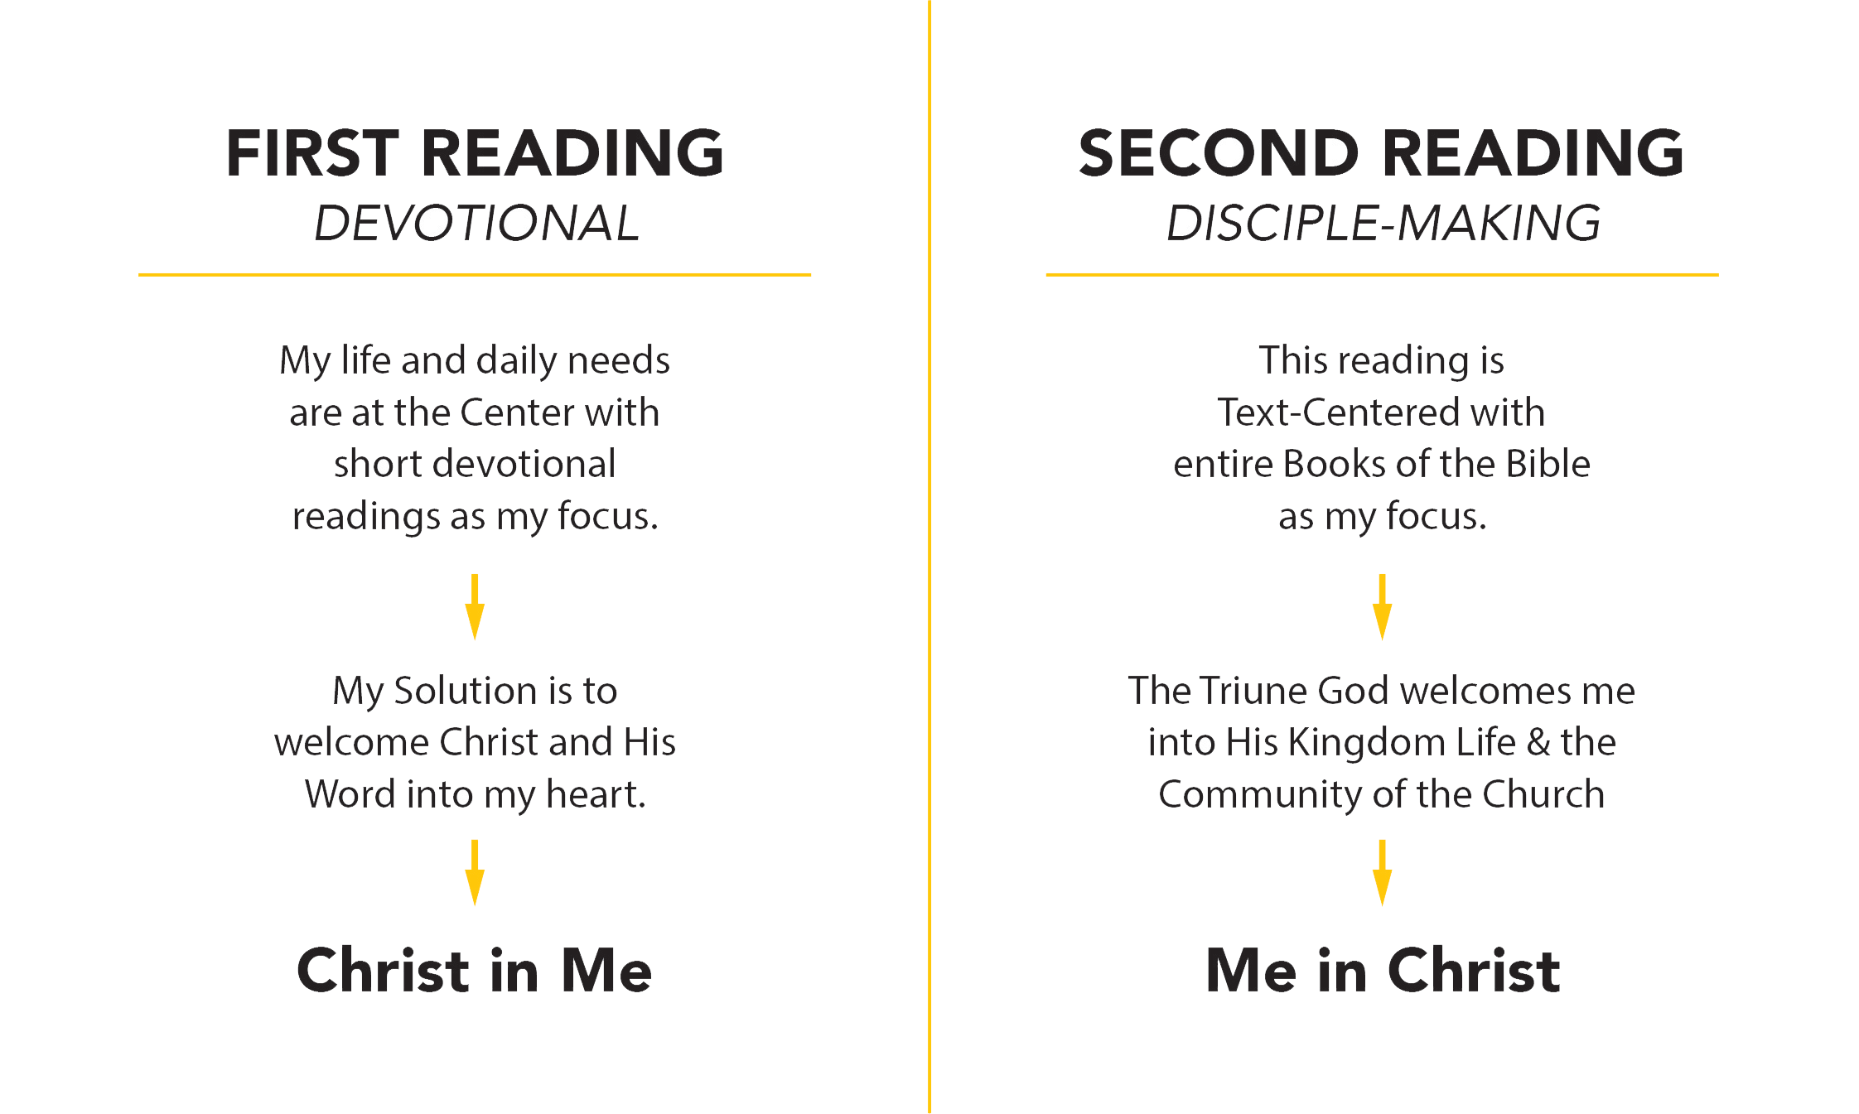

Slide 7
Why a Second Reading?
Because Scripture (esp. Jesus) insists upon it as an essential ingredient in Disciple-Making

Slide 8
Why a Second Reading?
¹⁸ Then Jesus came to them and said, "All authority in heaven and on earth has been given to me. ¹⁹ Therefore go and make disciples of all nations, baptizing them in the name of the Father and of the Son and of the Holy Spirit, ²⁰ and teaching them to obey everything I have commanded you. And surely I am with you always, to the very end of the age."
(Matt. 28:18-20 NIV)

Slide 9
Why a Second Reading?
¹⁸ "Hear then the parable of the sower.
¹⁹ "When anyone hears the word of the kingdom, and does not understand it, the evil one comes and snatches away what has been sown in his heart.
This is the one on whom seed was sown beside the road. (Matt. 13:18-19 NAS)

Slide 10
Why a Second Reading?
²³ "And the one on whom seed was sown on the good soil, this is the man who hears the word and understands it; who indeed bears fruit, and brings forth, some a hundredfold, some sixty, and some thirty." (Matt. 13:23 NAS)
Notes:
Neil Postman, the tech guru…says in his book “Technopoly,”
“Very few bad decisions are made today because we don’t have enough information; more often it is due to a lack of wisdom or interpretation.”
Our own Steve DeNeff says these words in his book Faultlines:
Most people grow not from information but from interpretation. The difference between when people grow and when they don’t isn’t how much new information they were acquiring. Most bad decisions are made not because of a lack of information, but because of a lack of either wisdom or courage. We lack wisdom when we don’t know when or how some principles apply to our lives; we don’t know what we should do.

Slide 11
Why a Second Reading?
²⁵ On one occasion an expert in the law stood up to test Jesus. "Teacher," he asked, "what must I do to inherit eternal life?”
²⁶ "What is written in the Law?" he replied. "How do you read it?"
(Lk. 10:25-26 NIV)
Notes:
²⁷ He answered, "'Love the Lord your God with all your heart and with all your soul and with all your strength and with all your mind'¹ ; and, 'Love your neighbor as yourself.'² "
²⁸ "You have answered correctly," Jesus replied. "Do this and you will live."
²⁹ But he wanted to justify himself, so he asked Jesus, "And who is my neighbor?"
(Lk. 10:27-29 NIV)

Slide 12
Why a Second Reading
Regarding “Interpretation”… See also
John 1:18
Luke 24:27 & 24:45
Acts 8:30-31
Nehemiah 8:8
Matthew 5:17-48
Luke 12:56
Acts 10:8; 15:12,14
Notes:
²⁷ He answered, "'Love the Lord your God with all your heart and with all your soul and with all your strength and with all your mind'¹ ; and, 'Love your neighbor as yourself.'² "
²⁸ "You have answered correctly," Jesus replied. "Do this and you will live."
²⁹ But he wanted to justify himself, so he asked Jesus, "And who is my neighbor?"
(Lk. 10:27-29 NIV)

Slide 13
Why a Second Reading?
Because Scripture (esp. Jesus) insists upon it as an essential ingredient in Disciple-Making
Because it is the Wesleyan Way of Disciple-making

Slide 14
Let’s Create a Wesleyan Culture of Disciple-making plan
5 Means of Grace
Wesley also called this “Working the ways of God.”
Lord’s Supper
Fasting
Prayer
Searching of the Scriptures (= STUDY not read)
Christian Conferencing (Society Meetings, Class Meetings & Wesley Bands)

Slide 15
    The Historical Question:
    Why did Whitefield’s revival in the US colonies end with his death, while the Wesleyan movement continued to thrive long after the death of its founder?
Notes:
Do you know that at the beginning of the 1860’s nearly 1/3 of the Christian Church in America were Methodists?
Did you know that EVERYONE in the Methodist movement were required to participate in a Class meeting?
Did you know that if you missed more than three (3) class meetings in a three month period, you were no longer permitted to participate?
And wherever Wesley traveled, the numbers in the church decreased? He “purged” the books of people who were no longer active participates in the disciple-making in the church.
Adam Clark, an early historian of Methodism, suggests a reason that is crucial to the understanding of spiritual movements and important for us to consider. Clark writes, “It was by this means—the formation of small groups—that we have been enabled to establish permanent and holy churches over the world. Mr. Wesley saw the necessity of this from the beginning. Mr. Whitefield, when he separated from Mr. Wesley, did not follow it. What was the consequence? The fruit of Mr. Whitefield died with himself. Mr. Wesley’s fruit remains, grows, increases, and multiplies exceedingly”.
In fact, in a correspondence with an old friend later in life, George Whitefield is said to have confessed,
“My brother Wesley acted wisely—the souls that were awakened under his ministry he joined in class (small groups), and thus preserved the fruits of his labor. This I neglected, and my people are a rope of sand.”

Slide 16
Adam Clark, an early historian of Methodism, writes,
“It was by this means—the formation of small groups—that we have been enabled to establish permanent and holy churches over the world. Mr. Wesley saw the necessity of this from the beginning.
Mr. Whitefield, when he separated from Mr. Wesley, did not follow it. What was the consequence? The fruit of Mr. Whitefield died with himself. Mr. Wesley’s fruit remains, grows, increases, and multiplies exceedingly”.
Notes:
Do you know that at the beginning of the 1860’s nearly 1/3 of the Christian Church in America were Methodists?
Did you know that EVERYONE in the Methodist movement were required to participate in a Class meeting?
Did you know that if you missed more than three (3) class meetings in a three month period, you were no longer permitted to participate?
And wherever Wesley traveled, the numbers in the church decreased? He “purged” the books of people who were no longer active participates in the disciple-making in the church.
Adam Clark, an early historian of Methodism, suggests a reason that is crucial to the understanding of spiritual movements and important for us to consider. Clark writes, “It was by this means—the formation of small groups—that we have been enabled to establish permanent and holy churches over the world. Mr. Wesley saw the necessity of this from the beginning. Mr. Whitefield, when he separated from Mr. Wesley, did not follow it. What was the consequence? The fruit of Mr. Whitefield died with himself. Mr. Wesley’s fruit remains, grows, increases, and multiplies exceedingly”.
In fact, in a correspondence with an old friend later in life, George Whitefield is said to have confessed,
“My brother Wesley acted wisely—the souls that were awakened under his ministry he joined in class (small groups), and thus preserved the fruits of his labor. This I neglected, and my people are a rope of sand.”

Slide 17
In fact, in a correspondence with an old friend later in life, George Whitefield himself confessed,
“My brother Wesley acted wisely—the souls that were awakened under his ministry he joined in class (small groups), and thus preserved the fruits of his labor. This I neglected, and my people are a rope of sand.”
Notes:
Do you know that at the beginning of the 1860’s nearly 1/3 of the Christian Church in America were Methodists?
Did you know that EVERYONE in the Methodist movement were required to participate in a Class meeting?
Did you know that if you missed more than three (3) class meetings in a three month period, you were no longer permitted to participate?
And wherever Wesley traveled, the numbers in the church decreased? He “purged” the books of people who were no longer active participates in the disciple-making in the church.
Adam Clark, an early historian of Methodism, suggests a reason that is crucial to the understanding of spiritual movements and important for us to consider. Clark writes, “It was by this means—the formation of small groups—that we have been enabled to establish permanent and holy churches over the world. Mr. Wesley saw the necessity of this from the beginning. Mr. Whitefield, when he separated from Mr. Wesley, did not follow it. What was the consequence? The fruit of Mr. Whitefield died with himself. Mr. Wesley’s fruit remains, grows, increases, and multiplies exceedingly”.
In fact, in a correspondence with an old friend later in life, George Whitefield is said to have confessed,
“My brother Wesley acted wisely—the souls that were awakened under his ministry he joined in class (small groups), and thus preserved the fruits of his labor. This I neglected, and my people are a rope of sand.”

Slide 18
    John Wesley’s Journal – August 25, 1763
    I was more convinced than ever, that the preaching like an Apostle, without joining together those that are awakened, and training them up in the ways of God, is only begetting children for the murderer. How much preaching has there been for these twenty years all over Pembrokeshire! But no regular societies, no discipline, no order or connection; and the consequence is, that nine in ten of the once-awakened are now faster asleep than ever.

Slide 19
A Pastor’s Job Description
Developing a Culture of
Disciple-making

Slide 20
A Pastor’s Job Description
Part 1: Preparation of Others

Slide 21
Pastors are “to prepare God’s people for the work of service so that the Body of Christ may be built up until we all reach unity in the faith and in the knowledge of the Son of God and become mature, attaining to the full measure of the fullness of Christ.” Ephesians 4:12-13

Slide 22
A Pastor’s Job Description
Part 2: Unity and Maturity

Slide 23
Pastors are “to prepare God’s people for the work of service so that the Body of Christ may be built up until we all reach unity in the faith and in the knowledge of the Son of God and become mature, attaining to the full measure of the fullness of Christ.” Ephesians 4:12-13
Notes:
Then two great tensions in the church must be done at the same time
Unity
Holiness

Slide 24
A Pastor’s Job Description
Part 3: From Saving to Sending

Slide 25
¹⁹ On the evening of that first day of the week, when the disciples were together, with the doors locked for fear of the Jewish leaders, Jesus came and stood among them and said, “Peace be with you!” ²⁰ After he said this, he showed them his hands and side. The disciples were overjoyed when they saw the Lord.²¹ Again Jesus said, “Peace be with you! As the Father has sent me, I am sending you.” ²² And with that he breathed on them and said, “Receive the Holy Spirit.
John 20:19-22

Slide 26
The primary mission of every church, every pastor and every church leader is to create a culture of Christo-formity in her people so that every believer will display the Presence of Christ to the World
Notes:
Michael Gorman – Cruci-formity
But I prefer the concept of Christo-formity – Scot McKnight
For it’s a dedication to be called by and shaped into the Image of a Person.

Slide 27
What Distracts the Church from Her Mission

Slide 28
Maybe we have accepted the separation between the Church & Ivory Tower.
Simply: We believe the Interpretation of the Word is a job best left to the professionals
Notes:
Let us as the deeper more effective professionals train pastors (aka, do the real work of discipleship) then the local church can teach the “professional tools”
May I simply say, “Discipleship IS THE WORK OF THE CHURCH.
And in the Wesleyan Way…there is not true academic freedom at IWU. Not the way it is defined and described by Harvard and Yale.
No. my boss is actually my DS, Mark Gorveatte and Dr. Wayne Schmidt.
Therefore, my task, my call, my spiritual responsibility is not as professor…but as pastor of the Crossroads District and the Wesleyan Church at large. And in the end, my spiritual calling is to serve the local church. So you can do the work of Disciple-making.
Ephesian 4:11 is often misread.
He gave some to be Apostles, some to be prophets, some to be evangelists, and some to be Pastors and teachers.
Grammatically, it might be better to read this as four “speaking roles in the church” and not 5. We should hyphenate pastor-teacher.
Notice a few things here. First, this is given by Christ. And its does not say he gives “gifts” to people. Rather, he gives “people to people”.
The definite article, which has been employed for each of the three categories mentioned so far, is repeated before “pastors” but omitted before “teachers.” What significance should be attached to this? Some have claimed that it indicates that the two groups are in fact identical (e.g., Barth, 438–39, who holds that one ministry only is being described, that of “teaching shepherds”). In Acts 13:1 those designated “teachers” in Antioch are shown exercising leadership while in the Pastorals teaching is a major role of the church leader (cf. 1 Tim 3:2; 5:17; Titus 1:9). But it is doubtful whether this is enough to demonstrate that the two ministries were always exercised by the same people. It is more likely that they were overlapping functions, but that while almost all pastors were also teachers, not all teachers were also pastors.
Lincoln, A. T. (1990). Ephesians (Vol. 42, p. 250). Dallas: Word, Incorporated.

Slide 29
Maybe we are more
“Revivalist” than “Wesleyan”
We have accepted the “Privatization” of an encounter with Jesus and maybe even accepting that this can take place apart from His Body (The Church)
Notes:
What is keeping us from accomplishing this?
Most Wesleyans in the US have dual “citizenship”.
First, we are products of the Wesleyan movement started in England in the 18th Century. Meaning: we are Anglican to the core in theology (Wesley’s abridgment of 39 Articles of Religion…abridged down to 25 Articles of Religion). Plus, with deep seated passion on Discipleship with the hope and expectation of holiness of heart and mind in THIS lifetime.
Second, we are products of the 18th and 19th Century Great Awakening in the US; with even deeper roots in the traditions of the 19th century camp meetings. This great movement of the Spirit gave rise to a moral recovery in the US…but also that the individual could become a believer by his/her choice at any time and any place (aka, outside of the Church and outside of accountability of the Body of Christ). I would argue that the latter has morphed into generic evangelicalism … which is now predominantly our adopted family.
I will try to argue that we can and must recover our Wesleyan roots, heritage, and value of the Church and our needing of one another as we pursue a holy life and we share the goal of Wesleyans to recover the vast reality of Kingdom dwelling in the here and now.
We no longer have an encounter with the Triune God; just our friend Jesus.

Slide 30
Maybe we are more
“Evangelical” than “Wesleyan”
Evangelism vs. Discipleship
Decisions for Christ vs. Disciples of Christ
Notes:
Part of this new Revivalist citizenship, This causes us to ask the question about our Theology of Conversion.
We talk about Salvation as arrival or as the destination rather than the beginning
We talk about conversion-salvation an the most important event in ones life and discipleship as optional equipment.
We have heard a message. We have been “moved in our spirit.” We have prayed a prayer. We have testified to a new “principle of life.”
This is often based more on a theology of the 4 Spiritual Laws than of the Power of the Triune God to free us from slavery to Sin and adopting us as His Children.
We “Evangelicals” have a more “transactional” model of Salvation than one that is “transformational.”
We invite Jesus into our heart…rather than allowing Him to Invite us into relationship with the Triune God and HIS BODY of Believers to hold us accountable to the confession we have declared.
We are convinced someone can be “converted” without being followers in the midst of discipleship.
What if we, under the recommendation of Dallas Willard, and the model of the early church reverse engenieer the focus…and put a priority upon Discipleship and just let evangelism happen out of the overflow of transformed lives.
See also Alan Kreider, “The Patient Ferment of the Early Church.”

Slide 31
I must be frank in my feeling that a notable heresy has come into being throughout our evangelical circles, the widely accepted concept that we humans can choose to accept Christ only because we need Him as Savior and that we have the right to postpone our obedience –
AW Tozer, “I Call It Heresy”
Notes:
I believe we have often witnessed “prevenient Grace” at work in the life of a person. They have emotionally responded to a sermon or have been faced with a tragic event. The Spirit of God is beginning to awaken someone who has been long asleep.
But rather than allow the Spirit to do His full transformation work to manifest itself in a person; we declare them forgiven and having arrived. And they believe us.
Aka; once you have been “saved” you are then presented with an option to move ahead in discipleship. And in most evangelical churches, the you can “opt out” of discipleship.

Slide 32
Discipleship is the process of becoming who Jesus would be, if He was you!
- Dallas Willard

Slide 33
One who wants to become more like Jesus and thus systemically and progressively re-arranges the affairs of life to that end.
- Dallas Willard

Slide 34
Maybe we are more “Leaders” than “Disciple-makers”
We “pastor to metrics” more than “disciple towards transformation”
Notes:
We count “conversions” before that reach the level of Discipleship.
Early church did not permit someone to be baptized unless he was presented to the Church by a “sponsor.” The Sponsor would report to the church “fruit of repentance.” And it was normally seen over the period of catechism training and service over the course of three (3-yes 3) years. Alan Krieder, The Patient Ferment of the Early Church.”
What gets reported is what gets done. What we measure becomes one of the forces which shapes our Gospel. Our Gospel has become, “Jesus died to forgive you of your sins, so repent of them, trust in Jesus and start coming to church.”
Here me very carefully, Church MUST report these inputs. They tell us if we are wooing people to the Lord. Are we a sweet smelling aroma that people want to know more about.
Inputs are indeed the easiest to count.
What about counting funerals? What decisions did they make in their lives that allowed them to say NO to the world and YES to Christ; every day of their life? What were the disciplines and practices that “crucified them?” How and where did they become “adopted in to the Body” that made them ambassadors? What do their neighbors say about them? Especially folks that did not regularly attend Church. What was their witness like; especially to their enemies?
Inputs are the “easiest one’s to count. (1) Numbers in worship (2) Conversions-Baptism (3) Finances.
Outputs, Let’s call them “recalibration indicators”; when we say YES to Jesus’ voice, even when it costs or even more so, when it hurts. When our life reflects the Sermon on the Mount more now than last year (and we can tangibly document this). When finances have less of a pull on our decisions now than then. When we are freed from addictions and we no longer believe that temptations result in sin. We anticipate on finding victory. And what about to the larger community. Most “input” numbers reflect OUR church. But the Great Commission is to go to “All ethnic groups”…so what does racial reconciliation look like BECAUSE you and your church are present in the community. What about serving orphans, widows, and YES Immigrants. This is the Biblical call. AND we have no right or permission to abandon this call to a government entity. It is our, by the Call of God. And the only time this will get planted in a human heart is when you move someone from initial conversion to Discipleship in the Word of God
Survey of Pastors: 10% invest in leadership development (aka; mentoring and discipleship).

Slide 35
What are these metrics?
(1) Number of People or Gatherings
(2) Commitments to Christ
(3) Finances or Offerings
Notes:
But this assumes a generic evangelical understanding of the Gospel…
THIS IS NOT a Wesleyan theology of conversion.
Nor does it represent a Wesleyan Ecclesiology.
Most programs that are designed to plant a church-grow a healthy church or to energize/recreate a dying Church are primarily focused towards growing a healthy organization & respective programs…secondarily growing people and their spiritual transformation. And by transformation, I mean people’s conversion, reconciliation with community and repenting of individual and corporate sins.

Slide 36
Additional Metrics?
(4) Since we count people “individually”; we often count a Disciple similarly.
We MUST correct this…
A Disciple is only a disciple as he/she is a in a relationship with other Disciple-makers
Notes:
The Christian anthropologist, Paul Hiebert writes this way, “True communities are built on the realization that the autonomous individual is not a whole person. A person is whole only as he or she is a person-in-community.”
Desmond Tutu speaks similarly yet more directly,
“We say in our African idiom, 'A person is a person through other persons.' The solitary human being is a contradiction in terms…the completely self-sufficient person is a sub-human.”
John Wesley is the best when depicting the necessity of Christian Community in the life of transformation. From the preface of Wesley’s Hymns and Sacred Poems he said this, “Solitary religion is not to be found. Holy Solitaries is a phrase no more consistent with the Gospel than Holy Adulterers. The Gospel of Christ knows no religion but social. No Holiness other than social holiness.”

Slide 37
    The Modern Day Pastoral Question:
    What Kingdom possibility is created when men and women come together in an
    1. Accountable Church community to
    2. Read-Understand-Apply the Word
    3. All under the power of the Holy Spirit?
Notes:
Neil Postman, the tech guru…says in his book “Technopoly,”
“Very few bad decisions are made today because we don’t have enough information; more often it is due to a lack of wisdom or interpretation.”
Our own Steve DeNeff says these words in his book Faultlines:
Most people grow not from information but from interpretation. The difference between when people grow and when they don’t isn’t how much new information they were acquiring. Most bad decisions are made not because of a lack of information, but because of a lack of either wisdom or courage. We lack wisdom when we don’t know when or how some principles apply to our lives; we don’t know what we should do.

